Slide 1
Data Engineering
DRD Diagram and explanation
Team OkBoomer
Kester (P1922897)
Kelyn (P1935800)
Jason (P1837902)
Alwin (P1935996)

Slide 2
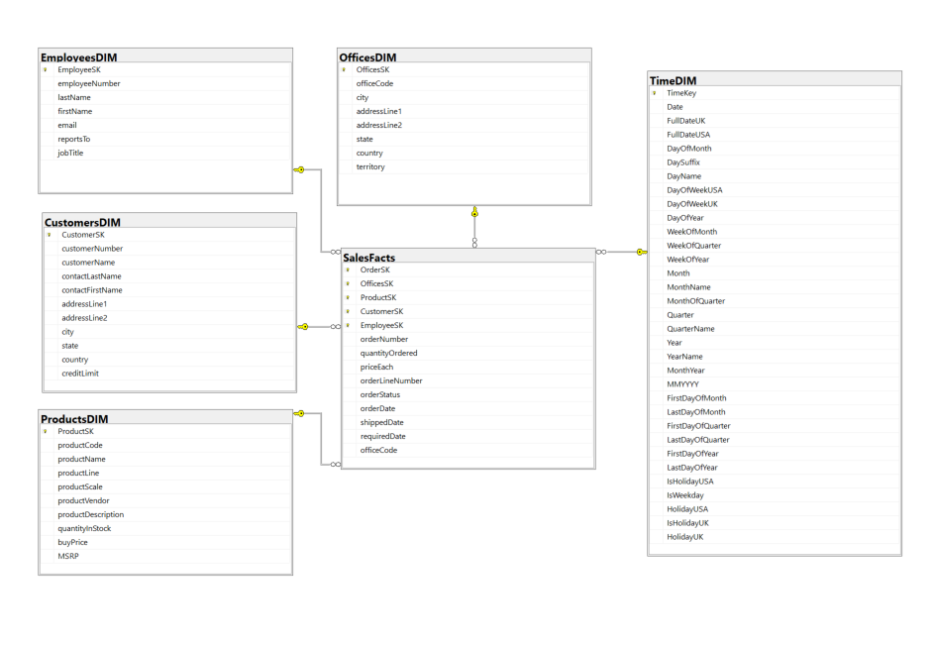

Slide 3
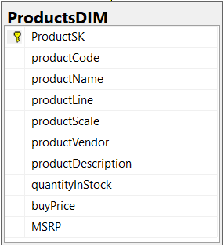
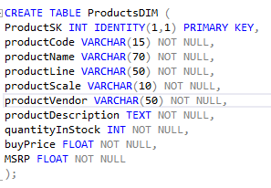
ProductsDIM
Purpose:
The ProductsDIM houses product information that has gone through the ETL process from the OLTP.
Explanation:
ProductSK acts as the surrogate and primary key instead of productCode, where it uniquely identifies each row information and increments by 1 for every new row inserted.
All the other columns are the same as the OLTP.

Slide 4
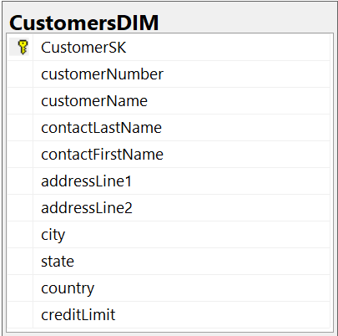
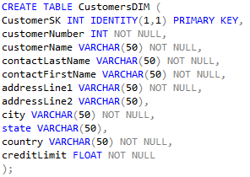
2. CustomersDIM
Purpose:
The purpose of this dimensional table is to contain customer’s information.
Explanation:
CustomerSK is a surrogate key and is now the primary key instead of customerNumber. It uniquely identifies each customer. Everything else matches the OLTP except that phone, postal code are now removed as they are redundant data for analytical purposes.

Slide 5
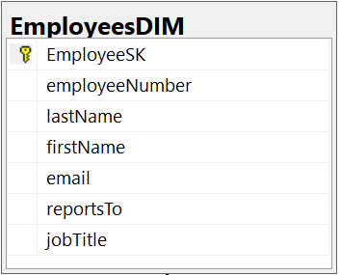
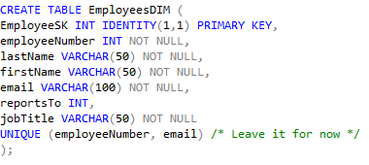
3. EmployeesDIM
Purpose:
The EmployeesDIM contains the information of employees.
Explanation:
employeeSK acts as the surrogate and primary key instead of employeeNumber.
Everything else is the same for the OLTP except officeCode, where it was moved to the SalesFacts.

Slide 6
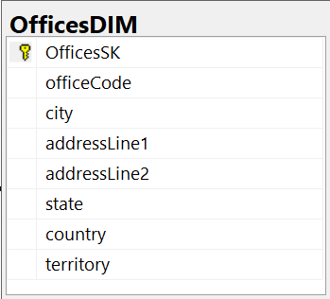
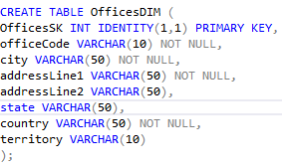
4. OfficesDIM
Purpose:
The purpose of this dimensional table is to provide structured information of the different offices for analytical purposes.
Explanation:
OfficesSK is a surrogate and primary key instead of the officeCode.
Everything else is the same as the OLTP except for phone and postalCode.

Slide 7
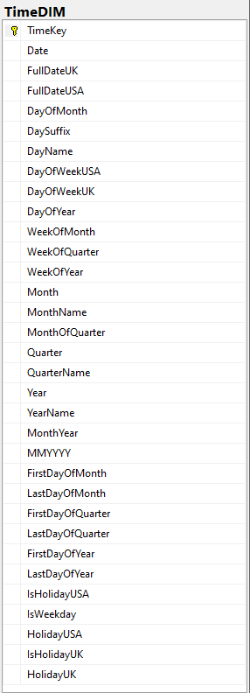
5. TimeDIM
Purpose:
The purpose of this dimension table is to contain information of all dates from the start of the business or the first order, to the end of the business or the last order.
This allows us to analyze the data efficiently with increased accuracy.
When writing out analytical queries, the TimeDimension will hold all the necessary values for analysis, making date operations much more performant.
Additionally, the TimeDimension allows for the standardisation of the dates and also allows for the storing of different date formats to cater for the differing Calendars, preventing additional coding in queries which can take a toll on performance.
Explanation:
They are date information

Slide 8
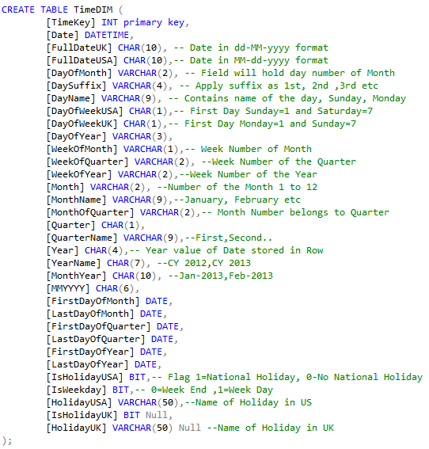

Slide 9
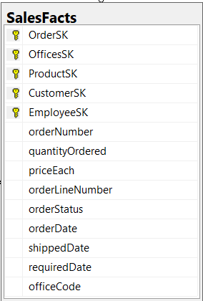
5. SalesFacts
Purpose:
The purpose of the fact table is to contain all information of the orders made by existing Customers and the information is focused on a business process such as Sales.
The Surrogate keys are not related to the business logic and through these references we can pull the necessary information for Queries.
Explanation:
The way we set up the fact table defines the way we Query our analysis. For example, through the way we did, it reduces the number of join(s), at most one or two depending on the expected analytical result.
In the table, we have 5 unique Surrogate Keys that reference their own respective dimension tables.

Slide 10
